Slide 1
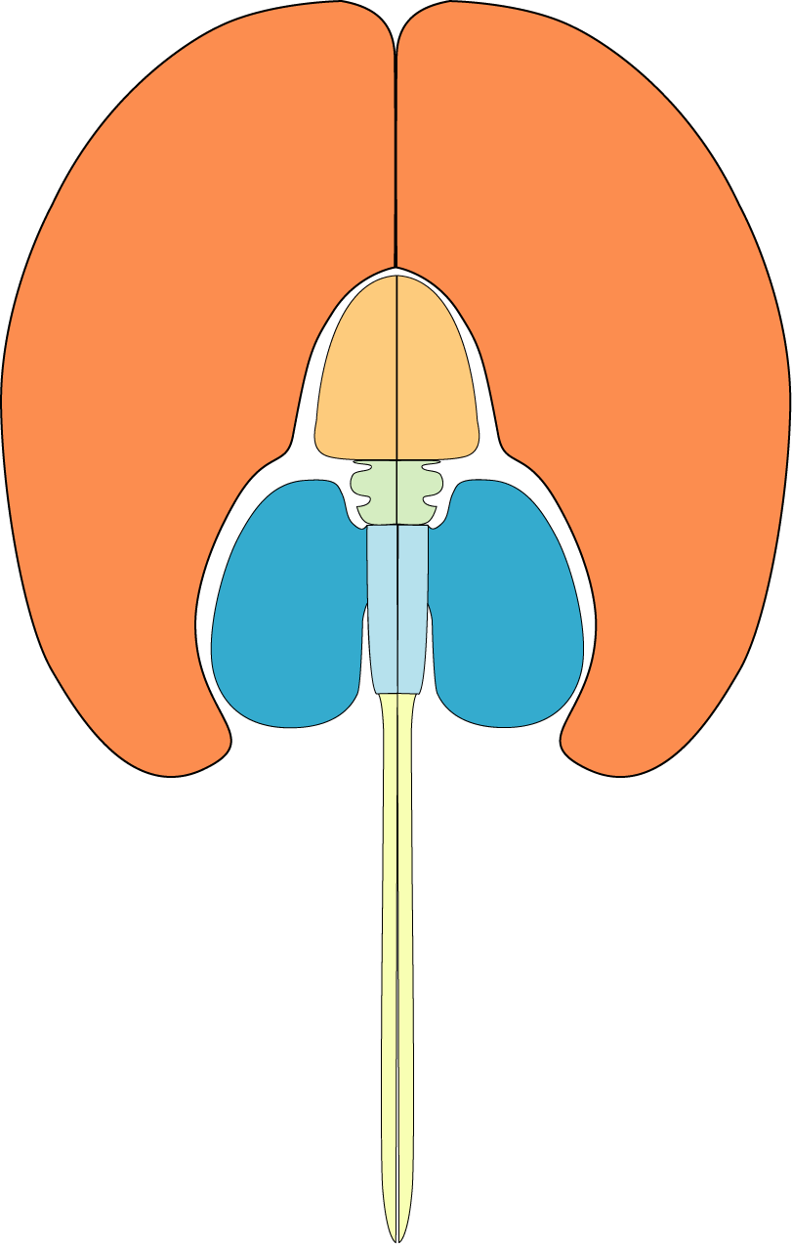
Telencephalon
Diencephalon
Thalamus
Hypothalamus
Midbrain
Cerebellum
Hindbrain
Brain Regions
You Should
KNOW
Spinal Cord

Slide 2
Thalamus
D o r s a l – S e n s o r y
Hypothalamus
V e n t r a l – M o t o r

Slide 3
Visual Pathways from Retina to CNS
Know the basic organization of visual system pathways, from retina to primary visual cortex and then continuing to other visual/cortical areas for processing of color, movement, and complex shapes (e.g., human faces).
Know the function of midbrain and hypothalamic pathways.
Know the differences in visual system organization between animals with eyes on the sides of the head (monocular depth perception) vs. front of the face (binocular depth perception).
Why do only the nasal retinas cross in humans? In other words, what would we see if these pathways did NOT cross? How does this relate to retinal disparity and depth/space perception?

Slide 4
Somewhere in Cortex
But don’t forget! We’ll have to do this 3 times, and maybe a 4th!
Color
Shape
Movement
The Retina
(ganglion cell receptive fields)

Slide 5
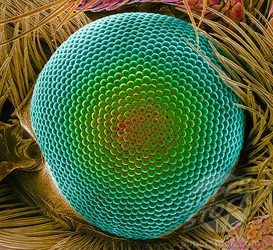
Somewhere in Cortex
But don’t forget! We’ll have to do this 3 times, and maybe a 4th!
Color
Shape
Movement
The Retina
(ganglion cell receptive fields)

Slide 6
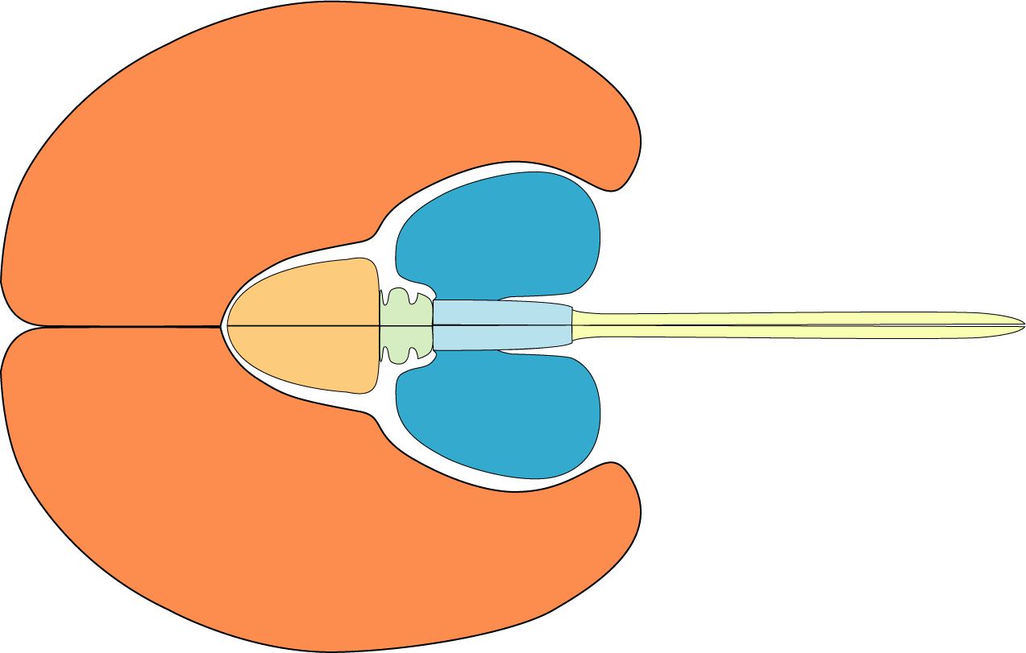
Primary Visual Cortex
Optic Nerve
LGN (thalamus)
Midbrain
Dorsal
Ventral
SCN (hypothalamus)
  Where does light (‘dots of contrast’) information go?
  Suprachiasmatic Nucleus (SCN, Biological Clock)
What vs. Where (Cortex vs. Midbrain)
Blind Sight (Midbrain) vs. Conscious Sight (Cortex)

Slide 7
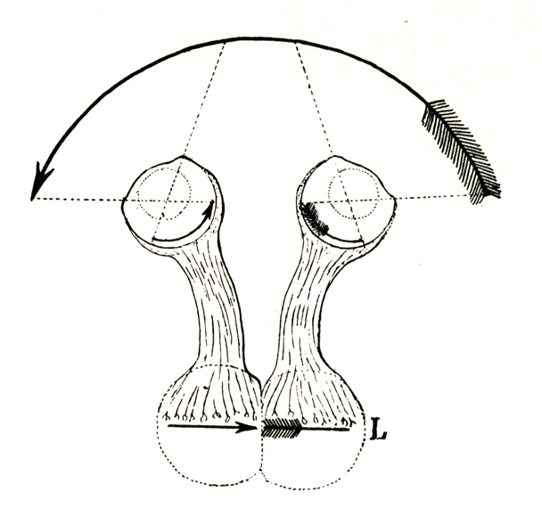
Prey animal: eyes on side of the head - each eye gets a different image
Normally, visual pathways ‘cross’ – the left half of the visual field is processed in the right half of the brain, and vice versa. WHY?
Well, with thanks to the clever Cajal, let’s have a look at what would happen if the visual pathways did NOT cross…
An incoherent image would be produced in the brain

Slide 8
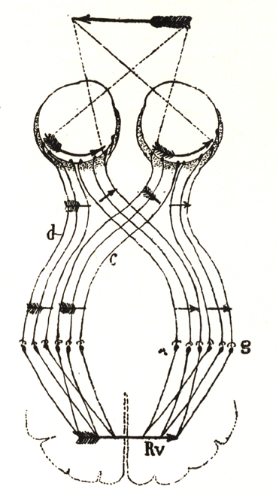
Human OR Predator:
Two (slightly different) Pictures of the Same Thing
Your ocular muscles insure that the image in each eye is split equally across nasal and temporal retinas
Color
Shape
Movement
The visual thalamus has 6 layers, 3 for each eye.

Slide 9
What happens when you cross your eyes?
Now the image is projected onto only one half of the retina.
Two important things happen…
d = optic nerve
c = optic chiasm
g = thalamus
Rv = right visual ctx

Slide 10
The purpose of the two images is to generate ‘binocular disparity’, which is greater when objects are close to us.
The visual system estimates the depth of an object based on binocular disparity.

Slide 11
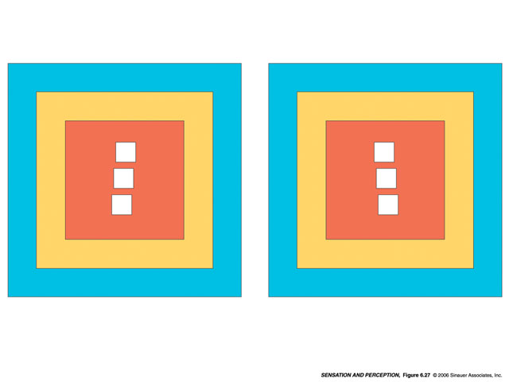

Slide 12
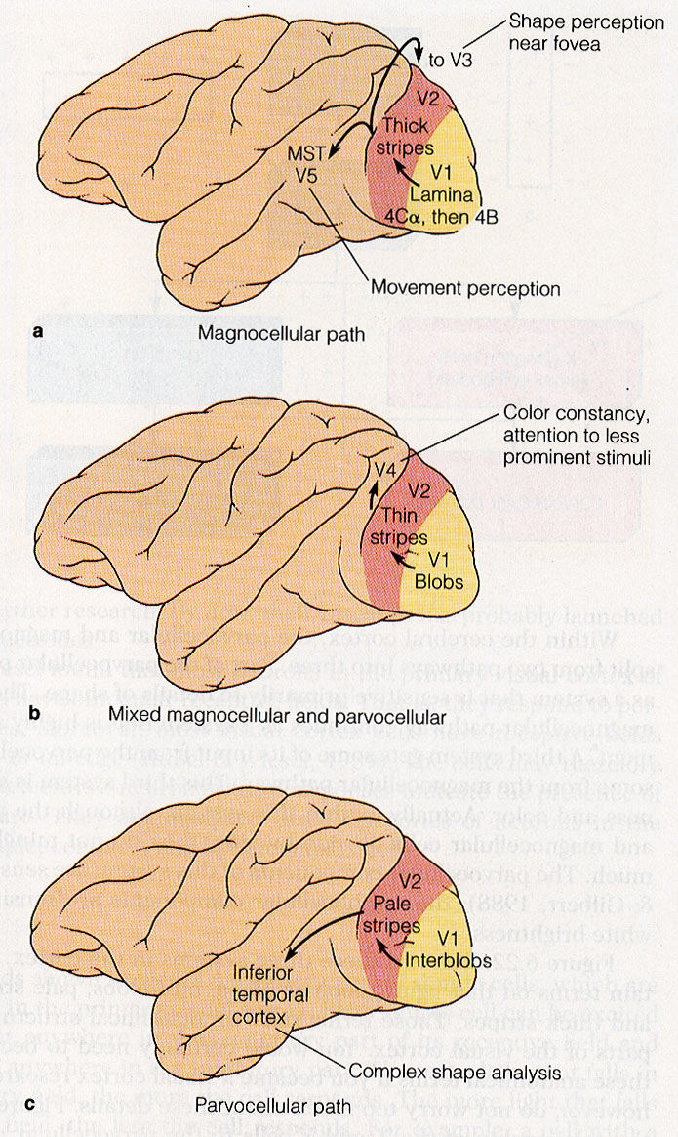
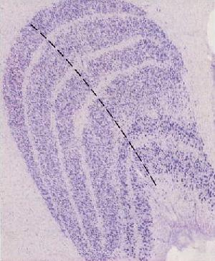
Movement
3 ‘channels’
leave the Retina
Color
Shape
Movement
Color
Each channel is destined for its own cortical processing area
It all begins here…
Shape
Face Processing

Slide 13
VISUAL PROCESSING IN CORTEX
Know the basic organization and function of primary visual cortex (the hypercolumn!).
As we move from retina to cortex, the response properties of cells in the visual system become increasingly complex. What synaptic mechanisms are used to produce cells that could respond to complex shapes (e.g., Geons) or movement?
Perception of Motion (why the retina can’t know whether something is moving or not).

Slide 14
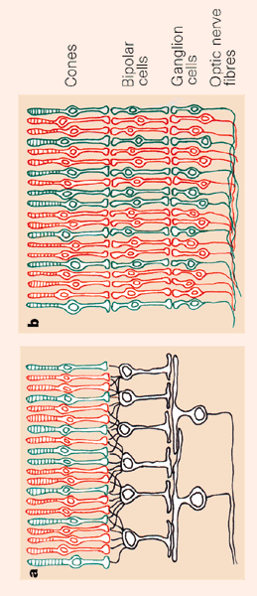
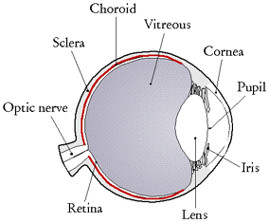
Review: What is leaving the RETINA?
light

Slide 15
retina
Eye-specific Layers
thalamus
Eye-specific Columns
cortex
A Surprise: The First Elements
of Shape Are Little Bars

Slide 16
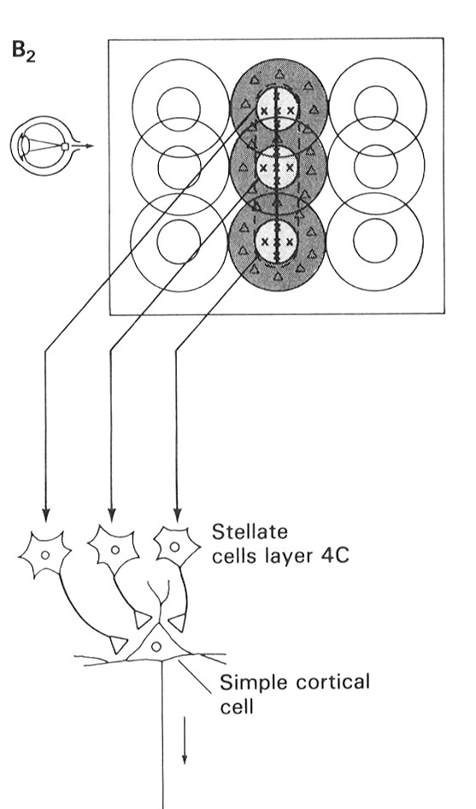
retina
retina
thalamus
Input Cells
thalamus
cortex
V1 Cortical Cell
cortex

Slide 17
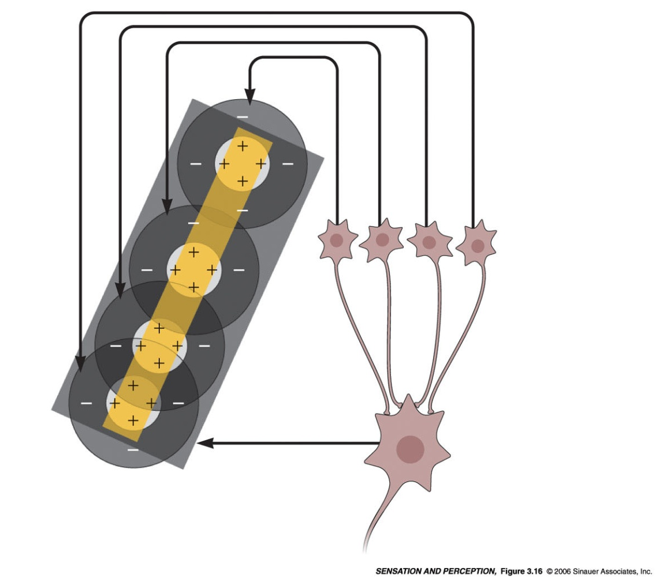
retina
retina
thalamus
Input Cells
thalamus
cortex
V1 Cortical Cell
cortex

Slide 18
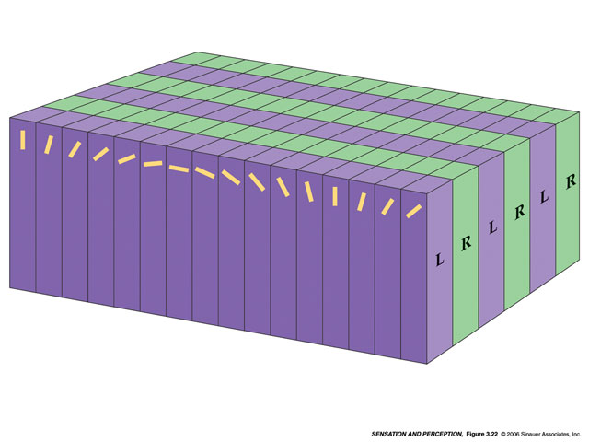
Primary Visual Cortex is a VAST ARRAY of HYPERCOLUMNS
(this example shows three hypercolumns)
Occular Dominance
Columns
Orientation Columns
3
2
1
Each column responds to a ‘bar’ of contrast with a specific orientation (Orientation Columns – specified by response). Orientation Columns are organized into Left and Right eye groups (Occular Dominance Columns – specified by input).

Slide 19
What does this mean?
Occular Dominance
Columns
Orientation Columns
3
2
1
A single Hypercolumn corresponds to ONE point in visual space. Everything that you could possibly see in that ONE point is already represented in the corresponding Hypercolumn. In other words, everything you can see is already represented in Primary Visual Cortex. If it isn’t there, you can’t see it.

Slide 20
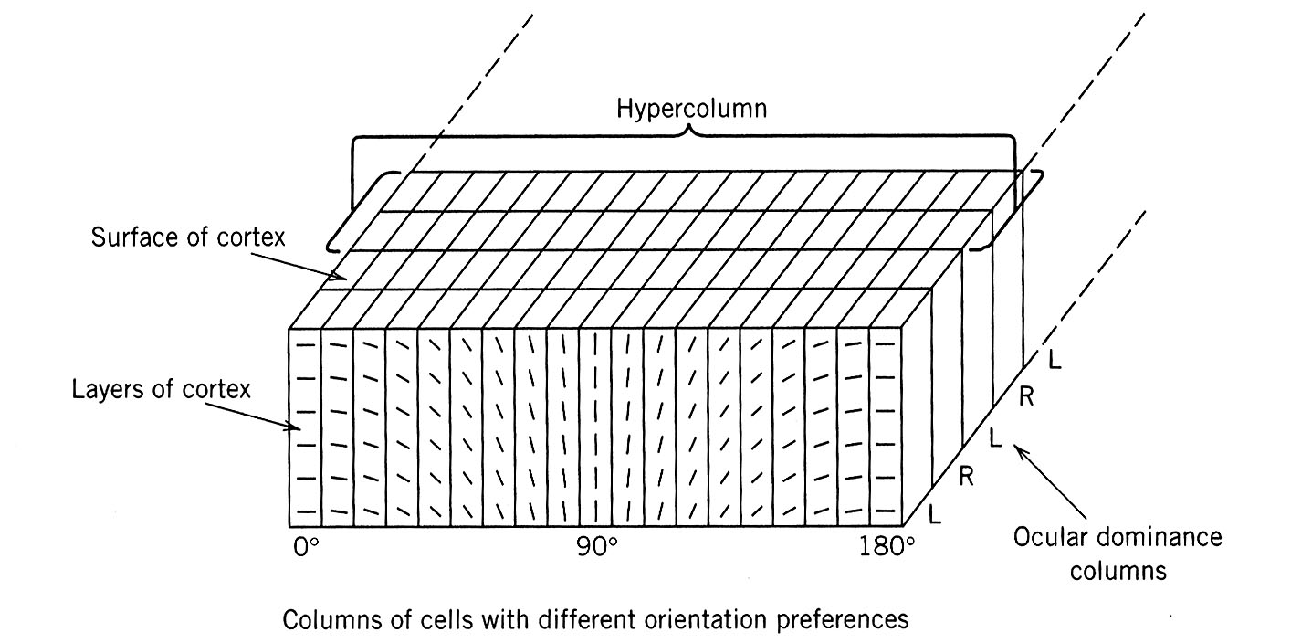
Point in visual space

Slide 21
Point in visual space

Slide 22
What happens when I show you an ‘X’ in your LEFT visual field?
Left nasal retina
Right temporal retina
L R
L R
Right Primary Visual Cortex

Slide 23
What does the visual system do
with all these little bars?

Slide 24
3 ‘dot’ detecting cells converge on a single ‘bar’ detecting cell in primary visual cortex (V1)
retina
thalamus
Input Cells
cortex
V1 Cortical Cell
Somewhere downstream, these 4 ‘bar’ detecting responses converge on a single ‘square’ detecting cell

Slide 25
Example of responses of a V2 cortical neuron to visual stimuli
Hedge and Van Essen, 2000

Slide 26
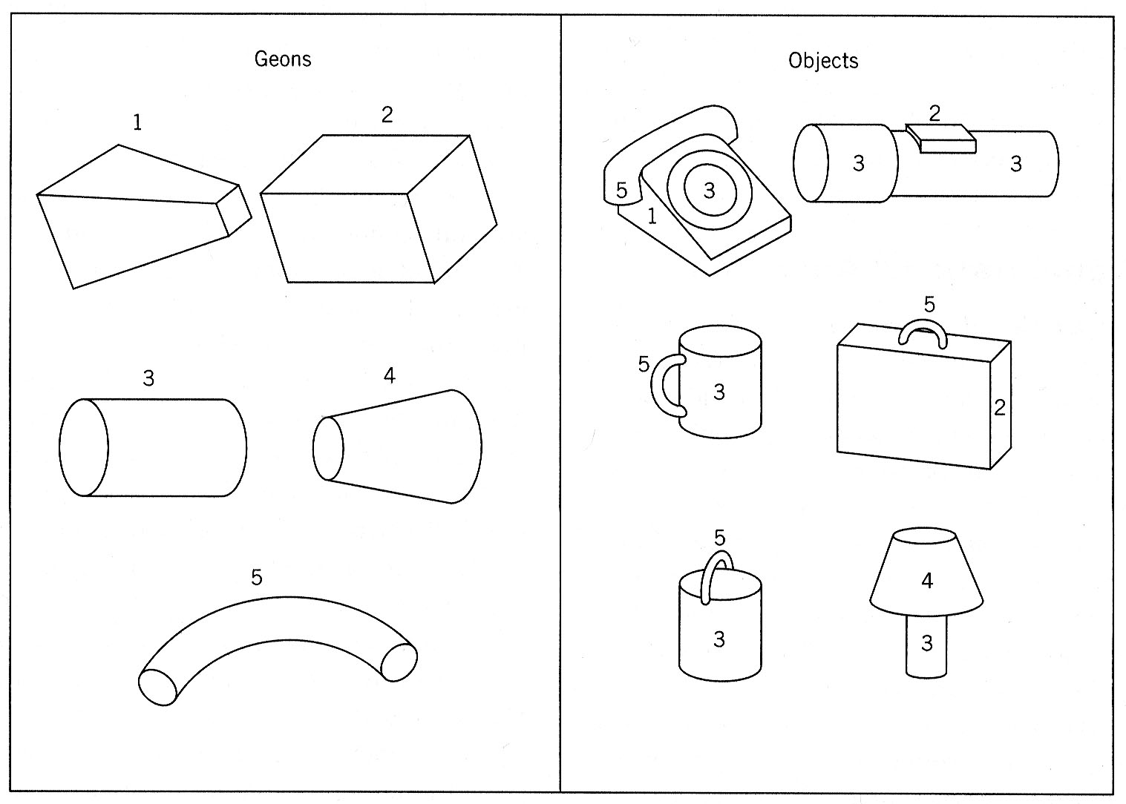
3 ‘square’ detecting cells converge on a single ‘cube’ detecting cell located in a tertiary processing area – etc., etc., …
Geons hypothesized to be ‘3D Shape Primaries’

Slide 27
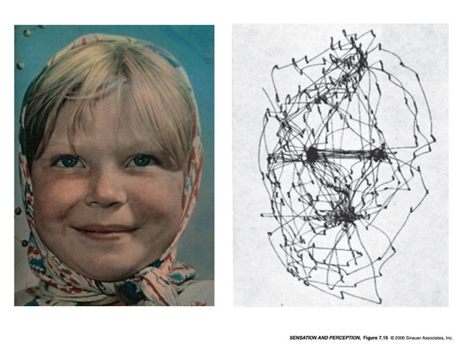
Movement
3 ‘channels’
leave the Retina
Color
Shape
Color
Movement
Each channel is destined for its own cortical processing area
It all begins here with little dots of contrast…
Shape
Face Processing

Slide 28
Why ‘saccadic’ eye movements?

Slide 29
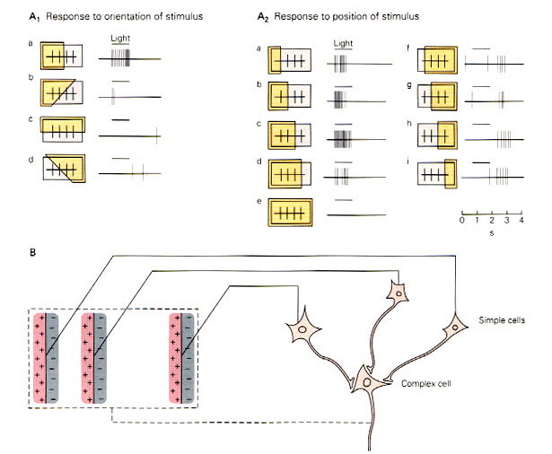
Many:1 patterns of connections can be used to make a ‘moving bar’ detecting cell
Delay lines. . .
I see a vertical bar of contrast moving left to right!

Slide 30
Many:1 patterns of connections can be used to make a ‘moving bar’ detecting cell
Delay lines. . .
I see a vertical bar of contrast moving left to right!

Slide 31
What happens if the bar is moving too fast?
Delay lines. . .
Wha!!??

Slide 32
Star Moves Right
Why Motion Can’t Be ‘Sensed’
Eye Moves Right
The Pattern of Image Movement on the Retina is the Same!

Slide 33
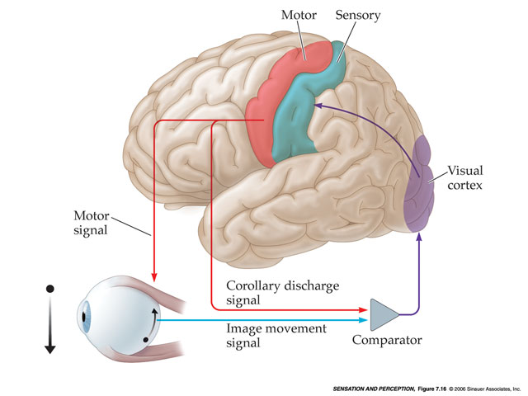

Slide 34
For More On The Visual Thalamus and visual cortex see ch. 3 of your book…
PAGE 62: The Lateral Geniculate Nucleus
  6 Layers (3 from each eye – shape, color, movement!)
  Top 4 layers (parvocellular layers) are shape and color
  Bottom 2 layers (magnocellular layers) are movement
PAGE 64: Striate Cortex (aka ‘Primary Visual Ccortex’, aka ‘V1’)
  Cortical magnification (most of your visual cortex is being used to process information from your fovea – this is very similar to somatosensory cortex, where the hands and face occupy a disproportionate amount of cortex – remember the homunculus!)
PAGE 68: Receptive fields in Striate Cortex
  Very similar to what I’ve talked about in class – cells respond to ‘bars’ of various orientations.
PAGE 72: Columns and Hypercolumns
  Should match up with the lecture material

Slide 35
What can visual cortex teach us about the nature/nurture debate?
Review ‘Nativism and Empiricism’ (p. 7 and 8 in your book).
What role is played by experience in the development of ocular dominance, orientation columns, and the visual system in general? How does this information help us understand ‘critical periods’ during development? What are the implications of these data for thinking about the roles of nature vs. nurture in human development?

Slide 36
Effects of Experience on Ocular Dominance Columns
Nativism vs. Empricism

Slide 37
‘Seeing’ Ocular Dominance Columns
Put Tracer in One Eye

Slide 38
Effects of Experience on Ocular Dominance Columns
Nativism vs. Empricism

Slide 39
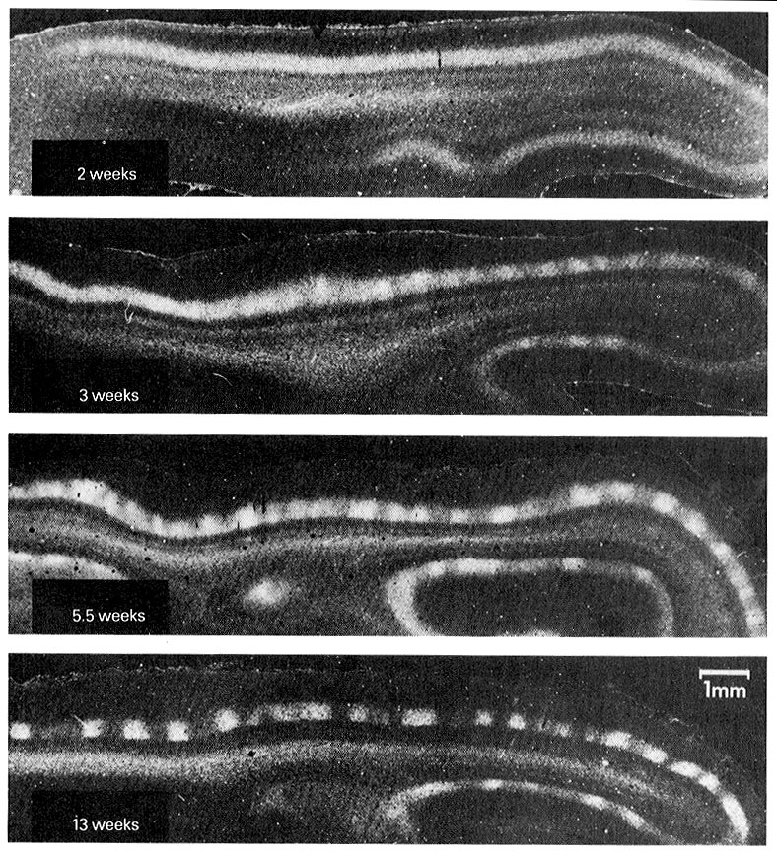
Effects of Experience on Occular Dominance Columns

Slide 40
Effects of Experience on Occular Dominance Columns
Normal Development
Raise Animal In The Dark
Adult

Slide 41
Sorry Empiricists!
Raise Animal In The Dark
Adult

Slide 42
What Happens If Sight Returns in Adulthood?
Raise Animal In The Dark
Adult
No Depth Perception Possible

Slide 43
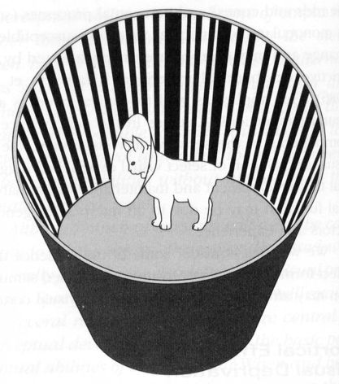
Effects of Experience on Orientation Specificity

Slide 44
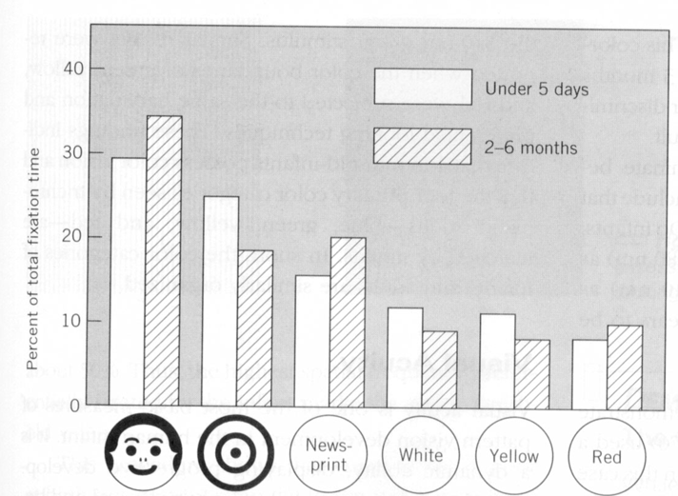
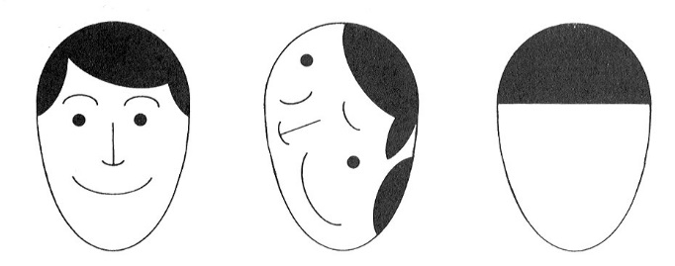
Are feature detectors ‘built in’?

Slide 45
What is ‘teaching’?
Are short attention spans in youngsters ‘abnormal’?
Remember empiricism?
Critical Periods
and
Puberty

Slide 46
100
80
Critical
Period
Lifespan
60
Chemical Element No.
40
20
0
R. Buckminster Fuller
0
1K
2K
3K
4K
5K
Recorded History
Key Points from this graph:
Nature assumes that the environment will change slowly, but in an unpredictable way – hence, ‘Critical Periods’ during early development.
Critical periods of development worked just fine several thousand years ago.
However, our cultural environment is now changing at an ever-increasing rate, violating Nature’s assumption of slow change. We need to keep learning NEW THINGS throughout our lifespan – new emphasis on ‘lifelong learning’.

Slide 47

Comments on Chapter 4: How does this relate to lecture material?
This chapter starts off with a discussion of ‘Middle Vision’ that includes a bunch of Gestalt Illusions. No need to memorize the names of these illusions, but it is VERY important to understand the historical significance of Gestalt Psychology. This is where the distinction between ‘sensation’ and ‘perception’ originates. The only way to explain Gestalt illusions is to invoke some process beyond sensation. For example, in the classic ‘face/vase’ illusion (see Fig. 4.26) you will note that ONE retinal image gives rise to MULTIPLE perceptions. This is where we get the saying ‘the whole is greater than the sum of the parts’. Another way to say that is ‘the perception is greater than the sum of the sensation’. As we’ve said before in this class, you want to think of sensation as a passive, analytic process and perception as an active, synthetic process.

Slide 48
Comments on Chapter 4: How does this relate to lecture material?
It is also worth thinking about the implications of Gestalt Psychology for Empiricism. The empiricists viewed the organism as a passive recipient of sensory information (an empty bucket, if you will). However, if an active, internal process of perception exists, notice that we cannot control exactly what goes in the ‘bucket’. The same sensation can be perceived differently by different individuals. Gestalt Psychology represented one of the first dents in the armor of Empiricism. The developmental studies on the visual cortex that we’ve discussed in class have likely cracked this armor open for good.

Slide 49
Comments on Chapter 4: How does this relate to lecture material?
Notice the similarity between the ‘Pandemonium’ model (Figure 4.21) and the story I told in class (What does the visual system do with all these little bars?). Also note the discussion of geons on p. 109 of your book.
As mentioned in lecture, complex shape processing occurs in the inferior temporal cortex. Damage to the inferior temporal cortex produces ‘prosopagnosia’ (face blindness). Beginning on p. 107 read the section ‘Object Recognition’ and continue reading through ‘Faces: An illustrative special case’.

Slide 50
Comments on Chapter 6: How does this relate to lecture material?
This chapter begins with a large section on Monocular Cues to 3D space (time to get out your video games!). How can images on a 2D television or computer screen seem 3D? You’ll find the answers here. Pay special attention to ‘motion parallax’, which is perhaps the most powerful of the monocular cues for depth. Used all the time in video games, movies, and television. If an animal has its eyes on the sides of its head, all depth perception will be monocular, using these types of cues. We use these cues IN ADDITION to the more powerful and accurate Binocular Disparity mechanism discussed below.
The next large section in Chapter 6 is on Binocular Vision. We’ve talked about this in lecture (that Cajal drawing in Slide 6). There is quite a bit of fancy terminology in the book, but bear in mind that all we are talking about is how the visual system uses DIFFERENCES between the two retinal images to COMPUTE depth perception (aka, stereopsis).

Slide 51
Comments on Chapter 6: How does this relate to lecture material?
Have some fun with the sections on stereograms.
Check out the section on Binocular Rivalry (p. 179). Recall that our depth perception mechanism uses two slightly different images of THE SAME THING to compute depth. What happens if we give the two eyes two COMPLETELY DIFFERENT images? Check out Figs. 6.49 and 6.50 and get crazy! This is the sort of thing that is going to happen if a person suffers from ‘strabismus’ (a mis-alignment of the two eyes, see p.183).

Slide 52
Comments on Chapter 8: How does this relate to lecture material?
Computation of Visual Motion (p. 222). Very similar to some of the slides above. Motion Perception is like Depth Perception – both must be ‘computed’ since neither can be ‘sensed’.
Apparent Motion (p. 224). Notice that nothing in the pictures is actually moving when you’re watching a ‘motion’ picture. Rather a series of still images are being rapidly flashed at you. The poor temporal resolution of our eyes caused us to see a continuous flow of smooth movement instead of a rapidly presented series of still pictures. Flashing about 24 pictures a second does the trick, and flashing them at a faster rate doesn’t make the motion seem any ‘smoother’. To make a motion picture, you must have a camera that can take at least 24 pictures per second (in the early days, cameras weren’t quite up to the task, so the motion in those old Charlie Chaplin movies seems jerky). Then you must have a device that can display at least 24 pictures per second. Now ask yourself, how do they do ‘slow motion’ in movies or on TV?

Slide 53
Comments on Chapter 8: How does this relate to lecture material?
Now ask yourself, why do movie DVDs (over 4GB) have to hold so much more data than an audio CD (650 MB)? Hint: an average single image (‘frame’) in a DVD movie is ~20 KB. Why do ‘Blu-Ray’ disks have to hold even more data?!
Detection of Global Motion in Area MT (p. 227). As discussed in lecture we have separate cortical regions for the perception of shape, color, and movement (as discussed repeatedly in lecture). MT is the name of the cortical region for the perception of movement

Slide 54
Comments on Chapter 8: How does this relate to lecture material?
Optical Stimulation for Motion Perception (starts on p. 232). There are several ways to perceive movement where in fact no movement exists. If you have a Windows PC, put on the ‘Starfield’ screensaver’ a fine example of optic flow patterns. I’m sure there is something similar for the Mac. You might also want to get out a video game and try to figure out how the game console tricks you into perceiving motion through space.
Eye Movements and the Problem of Motion Perception (p. 238-240). The problem is that the retinal image is the same whether things in the world are moving or whether you are moving. Thus, information about movement can not be directly ‘sensed’. Subtracting total image movement from movement caused by the muscles of the eye, head, and neck solves the problem.

